Slide 1

PREDICTING GREENLAND ICE SHEET MELTING
A MACHINE LEARNING APPROACH
ME-597: ARTIFICIAL INTELLIGENCE IN THERMAL SYSTEMS
TEAM:
KARTIK MAHESHWARI
NARMADHA BALRAJ
ADVISOR:
DR. VEERARAGHAVA RAJU HASTI

Slide 2
PROBLEM STATEMENT
“Global warming is affecting our environment at an ever-increasing rate and our actions to tackle the change are rather limited”
OBJECTIVE
“Using Machine Learning algorithms to predict the amount of Greenland Ice sheet that will melt by the year 2100 at given rate of rise of factors affecting global warming”

Slide 3

WHAT IS GLOBAL WARMING?

Slide 4
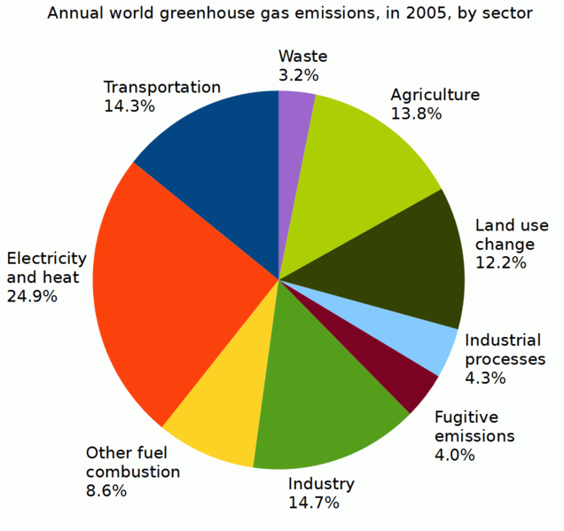
FACTORS LEADING TO GLOBAL WARMING
Carbon Dioxide [CO₂] Emission
Methane [CH4] Emission
Nitrous Oxide [N2O] Emission
Temperature
Sea Water
Population
Deforestation
Atmospheric Water Vapor [H₂O]]
Milankovitch Cycle
Global Ice Sheets
Atmospheric Currents
Earth’s Albedo

Slide 5
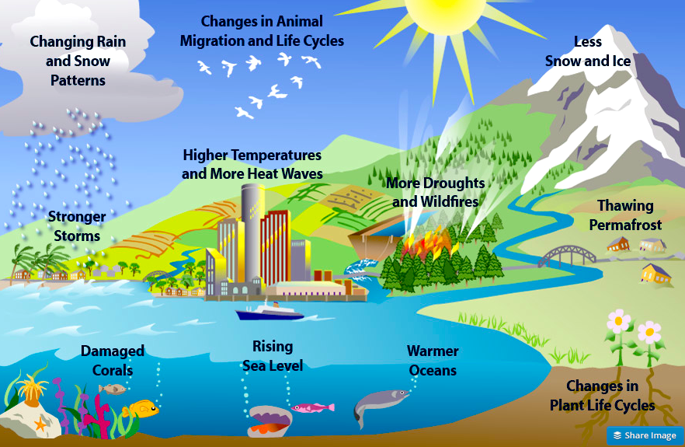
HOW CLIMATE CHANGE AFFECTS US?

Slide 6
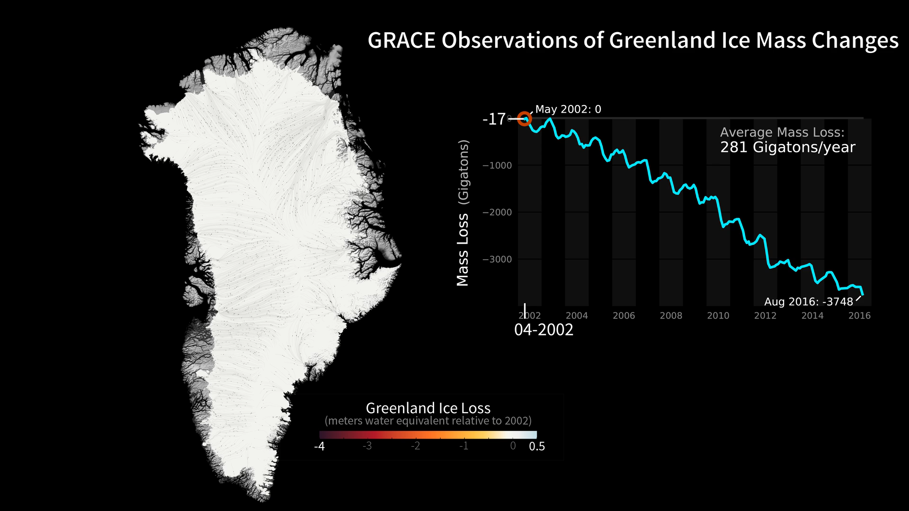
GREENLAND:

Slide 7
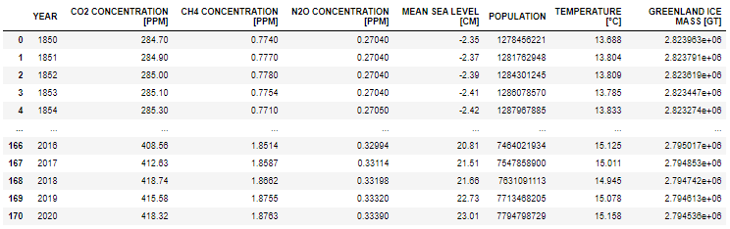
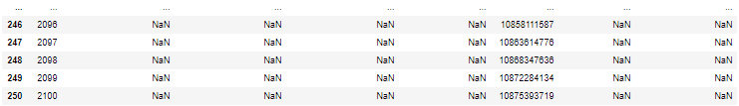
DATASET
This dataset is manually scrapped and compiled.
SOURCE: NOAA Paleo Ice-core Dataset | CSIRO | UN Census | Berkeley Earth Lab | NASA

Slide 8
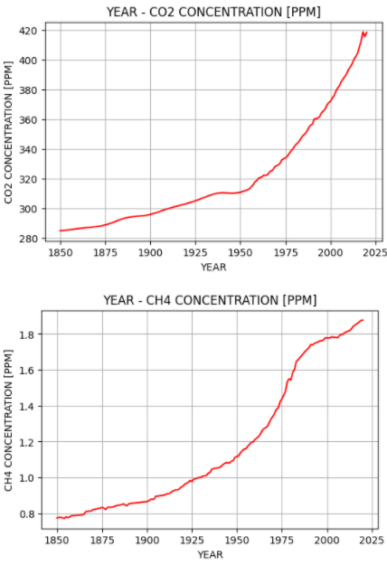
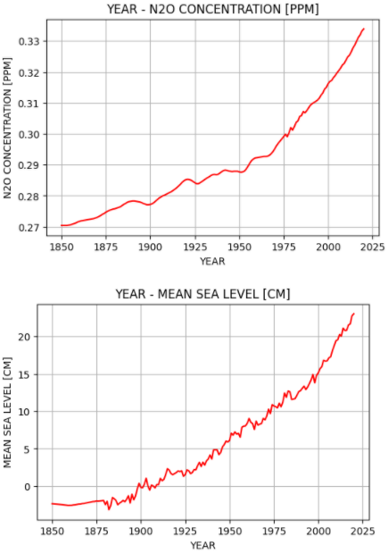
EXPLORATORY DATA ANALYSIS

Slide 9
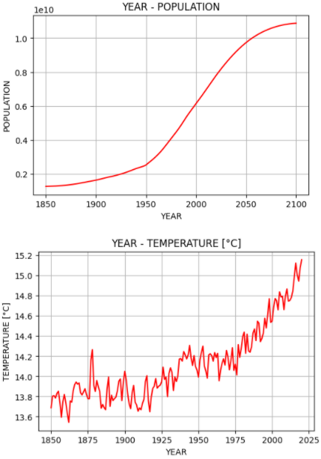
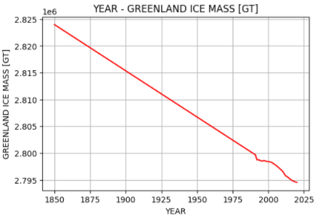
EXPLORATORY DATA ANALYSIS

Slide 10
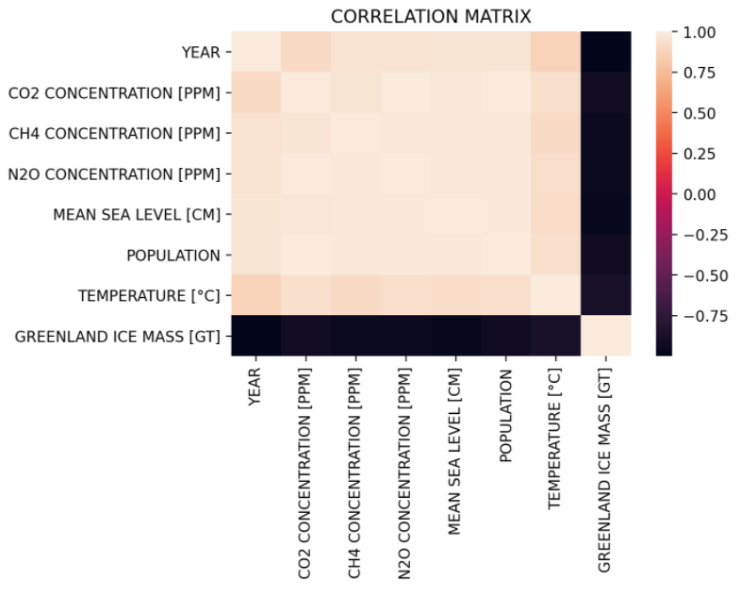
EXPLORATORY DATA ANALYSIS
CORRELATION MATRIX [HEAT MAP]

Slide 11
METHODOLOGY
EXPLORATORY DATA ANALYSIS
MODEL GENERATION
MODEL EVALUATION
DATA AUGMENTATION
ORIGINAL DATA
EXPLORATORY DATA ANALYSIS

Slide 12
DATA AUGMENTATION
CO₂ CONCENTRATION
Train for Year-CO₂-Population dataset [1850-2020]
Predict CO₂ based on Year-Population dataset [2021-2100]
CH₄ CONCENTRATION
Train for Year-CO₂-CH₄-Population dataset [1850-2020]
Predict CH₄ based on Year-CO₂-Population dataset [2021-2100]
N₂O CONCENTRATION
Train for Year-CO₂-CH₄-N₂O-Population dataset [1850-2020]
TEMPERATURE
GREENLAND ICE MASS
Train for Year-GHGs-Population-Temperature dataset [1850-2020]
MEAN SEA LEVEL
Train for Year-GHGs-MeanSeaLevel-Population-Temperature dataset [1850-2020]
Train for Year-GHGs-MeanSeaLevel-Population-Temperature-Greenland Ice Mass dataset [1850-2020]
Predict N₂O based on Year-CO₂-CH₄-Population dataset [2021-2100]
Predict Temperature based on Year-GHGs-Population dataset [2021-2100]
Predict Mean Sea Level based on Year-GHGs-Population-Temperature dataset [2021-2100]
Predict Gn’land Ice Mass based on Year-GHGs-MeanSeaLevel-Population-Temperature dataset [2021-2100]

Slide 13
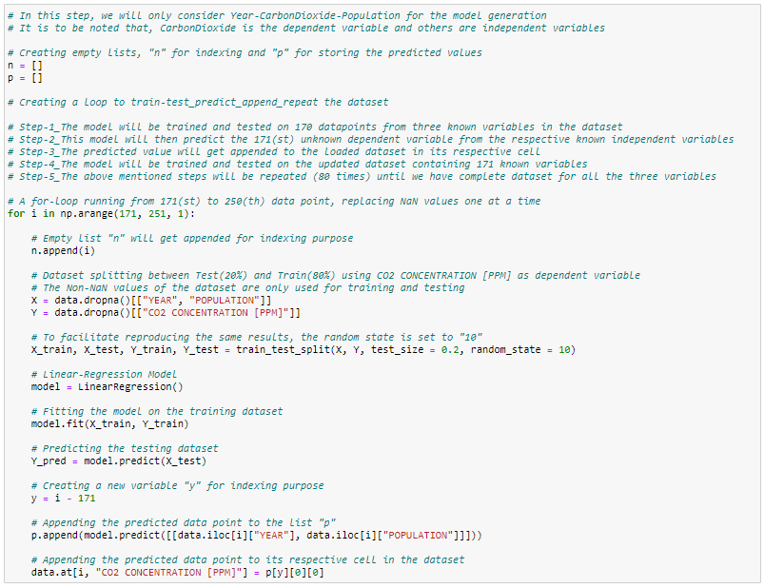
LINEAR REGRESSION

Slide 14
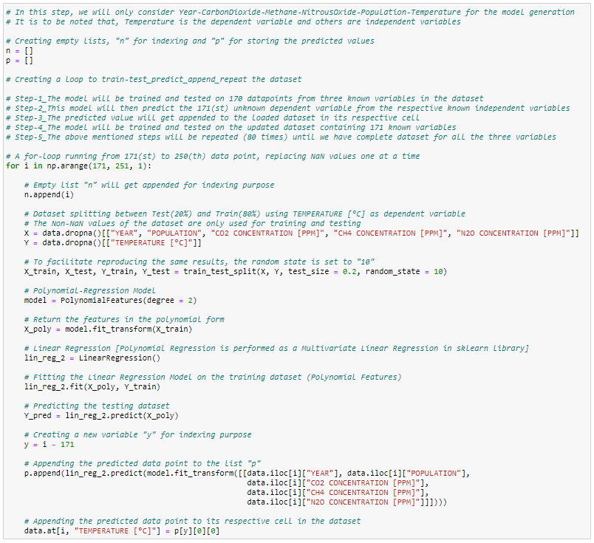
POLYNOMIAL REGRESSION

Slide 15
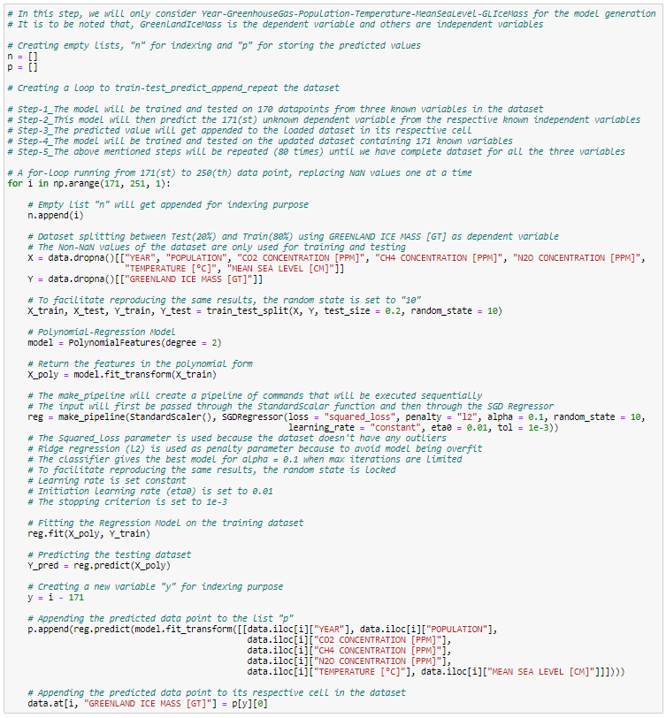
POLYNOMIAL REGRESSION [SGD]

Slide 16
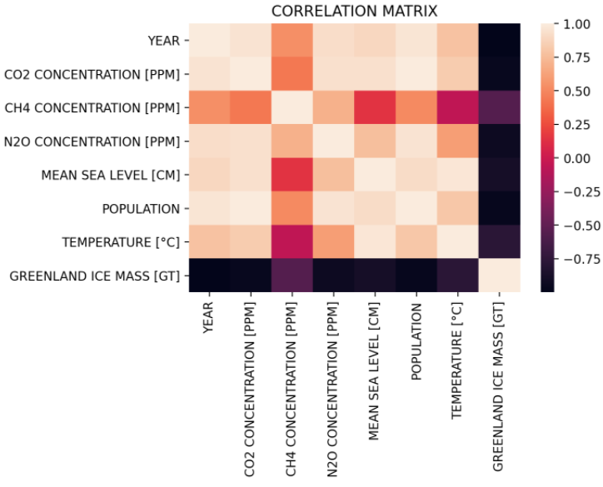
AUGMENTED DATASET
CORRELATION MATRIX [HEAT MAP]
POLYNOMIAL REGRESSION MODEL

Slide 17
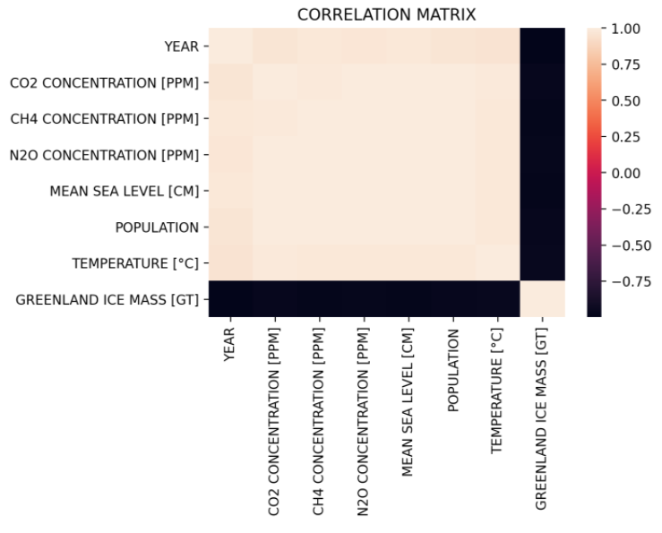
AUGMENTED DATASET
CORRELATION MATRIX [HEAT MAP]
POLYNOMIAL REGRESSION [SGD] & LINEAR REGRESSION MODEL

Slide 18
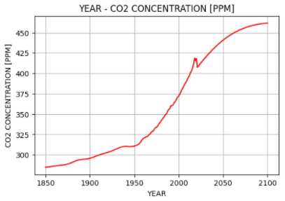
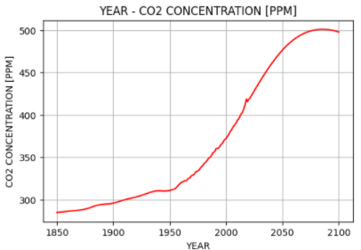
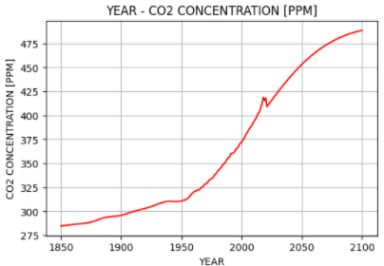
AUGMENTED DATASET
YEAR – CO₂ CONCENTRATION [PPM]
LINEAR
POLYNOMIAL
POLYNOMIAL [SGD]

Slide 19
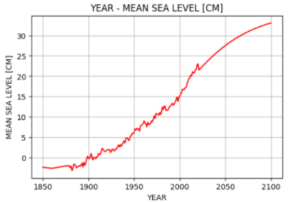
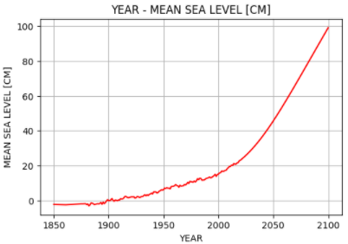
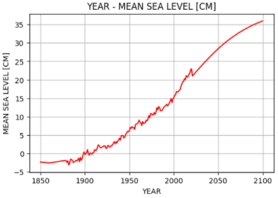
AUGMENTED DATASET
YEAR – MEAN SEA LEVEL [CM]
LINEAR
POLYNOMIAL
POLYNOMIAL [SGD]

Slide 20
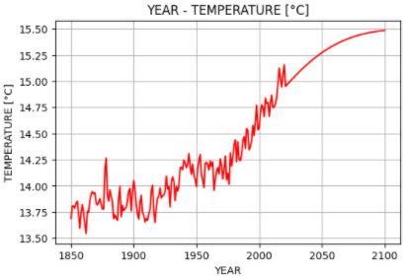
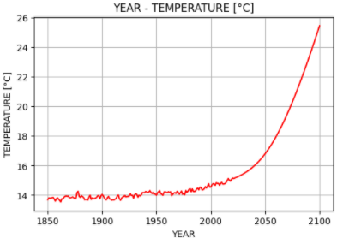
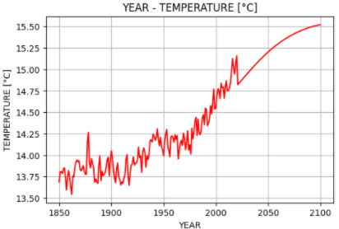
AUGMENTED DATASET
YEAR – TEMPERATURE [°C]
LINEAR
POLYNOMIAL
POLYNOMIAL [SGD]

Slide 21
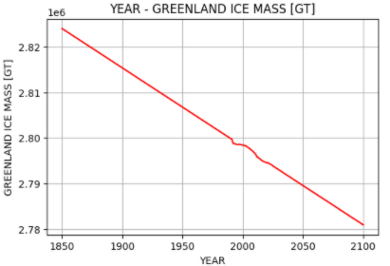
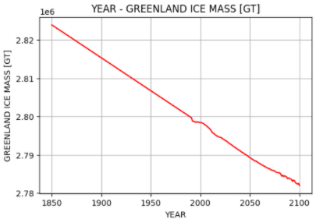
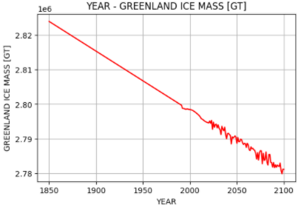
AUGMENTED DATASET
YEAR – GREENLAND ICE MASS [GT]
LINEAR
POLYNOMIAL
POLYNOMIAL [SGD]

Slide 22
MODEL EVALUATION
 | LINEAR REGRESSION | POLYNOMIAL REGRESSION | POLYNOMIAL REGRESSION [SGD]
R-Squared Score | 0.99996 | 0.99984 | 0.99674
Training Loss Greenland Ice Mass [GT] | 82.70976 | 118.65132 | 2550.54848
Validation Loss Greenland Ice Mass [GT] | 118.33943 | 237.99721 | 6747.88796
Model Fit | Near Perfect Fit | Slight Overfit | Overfit

Slide 23
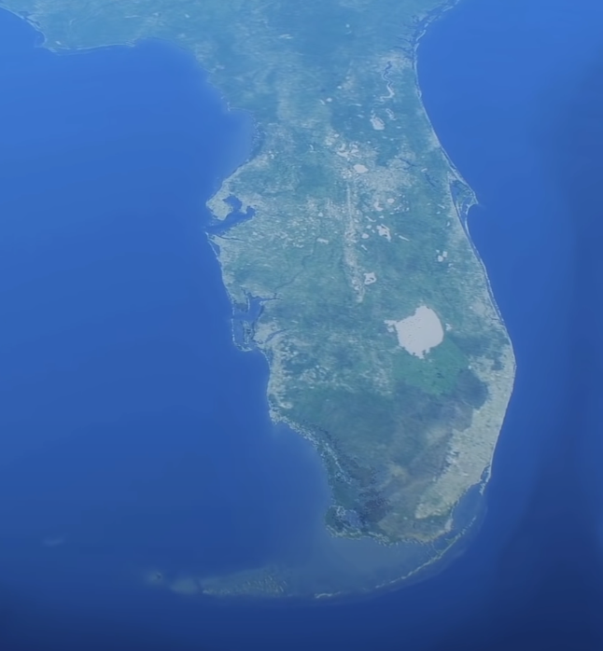

CONCLUSION
According to our model (all three), the projected Greenland Ice Sheet melt over the course of next 80 years will raise global mean sea levels by at least 21 cm
In comparison, sea level rose by this much over the course of last 150 years
FLORIDA 2020 >>> 2100
World will perhaps face the biggest humanitarian and environmental crisis it has ever faced
Climate change in Greenland has already crossed the point of no return (early 2000s)
Global Warming, we cannot stop it, but can surely slow it down and the greatest tool at our disposal to help us achieve this is Machine Learning and Artificial Intelligence

Slide 24
WHAT COMES NEXT?
Nuanced hyper parameter tuning could yield better results
Implementing Neural Networks and Physics based Machine Learning Models for forecasting
Including more features in the dataset such as atmospheric water vapor concentration, atmospheric currents, ice sheet area, Earth’s albedo, deforestation, etcetera
Using bigger datasets with data points for daily or even monthly anomalies could yield better results

Slide 25
THANK
YOU

